Slide 1
Essential Features of a Comparative Experiment

Slide 2

The Generation 100 Study
Norwegian University of Science & Technology
https://www.ntnu.edu/cerg/generation100

Slide 3
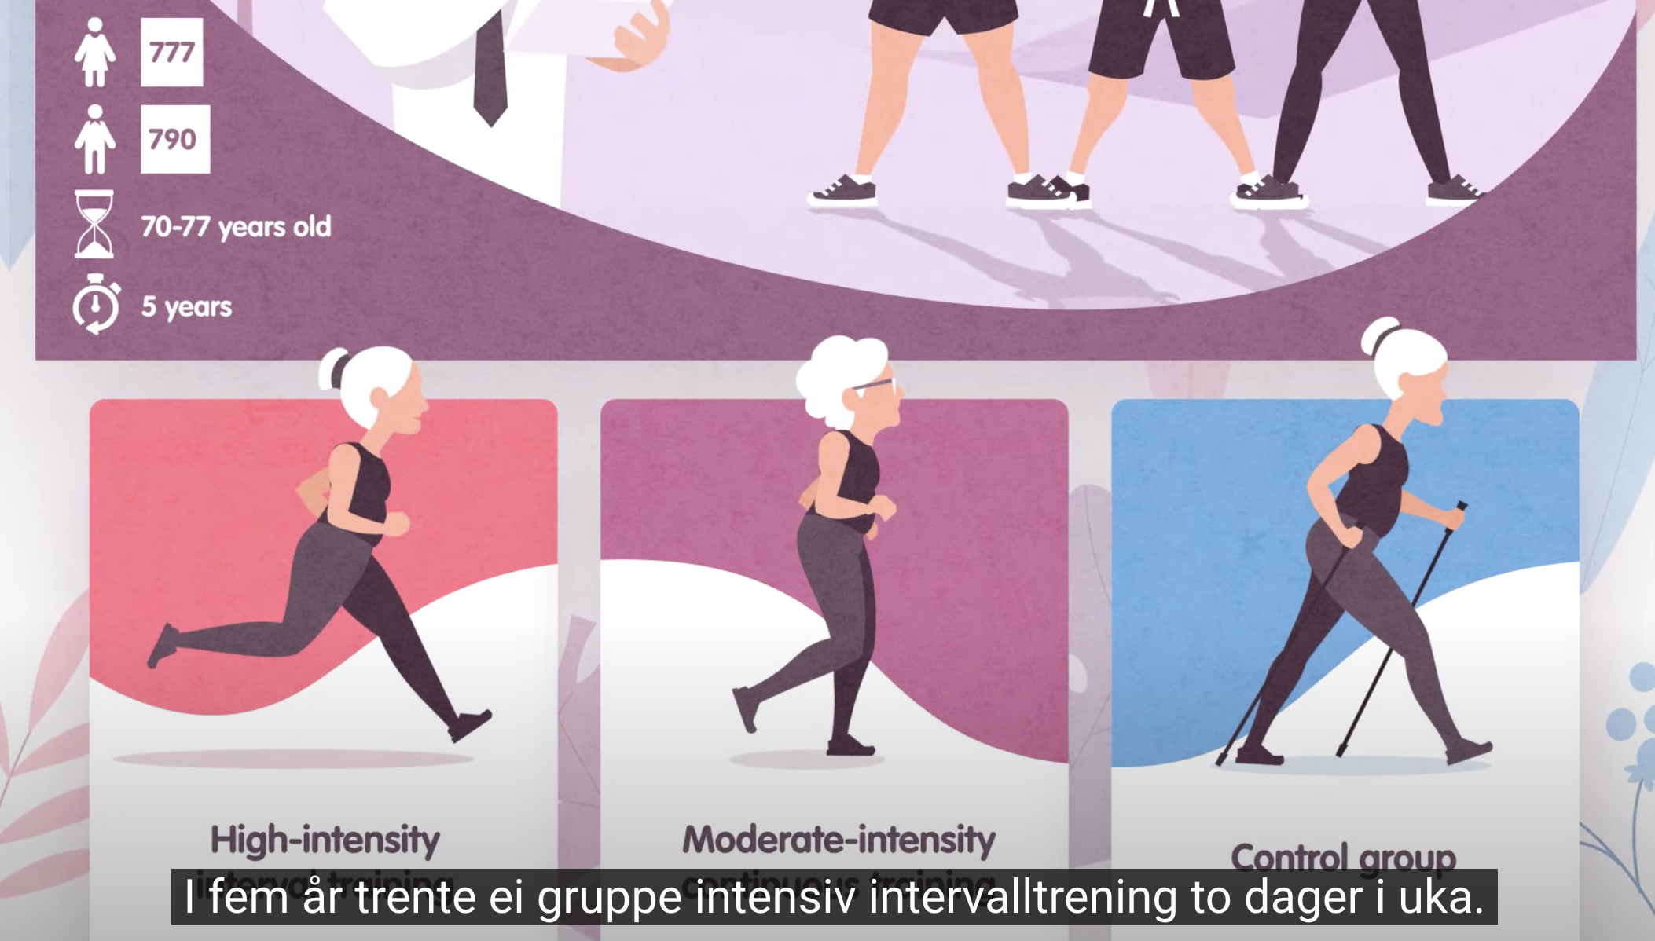
Treatment groups
CERG CERG on Youtube
https://www.youtube.com/watch?v=EJOPNG4fuIc&t=2s

Slide 4
Randomization

Slide 5
Blinding (a.k.a. masking)

Slide 6
Blocking

